Slide 1

INTRO
TO
PROGRAMMING
ROB SPECTRE
@BOXEE_API

Slide 2
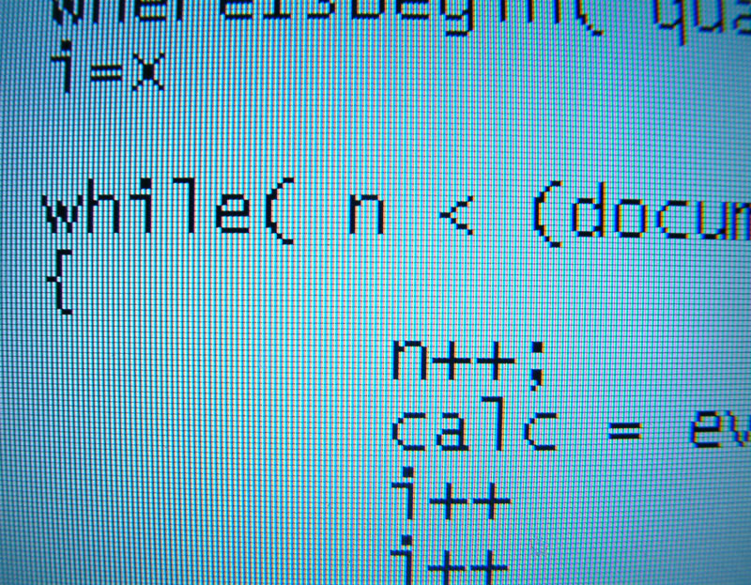

WHAT IS
PROGRAMMING?

Slide 3
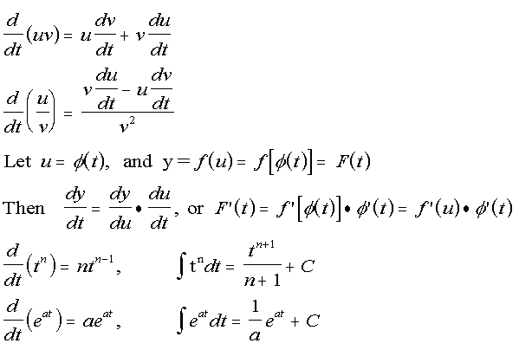
PROGRAMMING IS
MATH

Slide 4
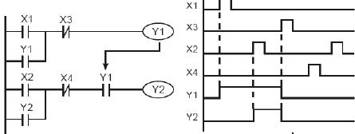
PROGRAMMING IS
PRACTICAL MATH

Slide 5
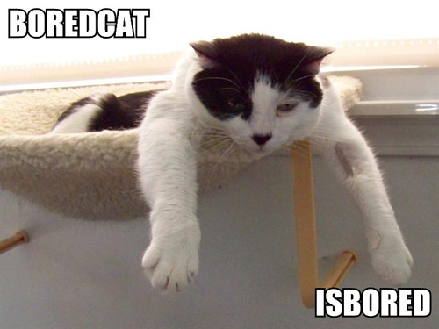
IS ANYONE ELSE
BORED?

Slide 6

FORGET THAT NOISE
LET'S TALK ABOUT VIDEO GAMES

Slide 7
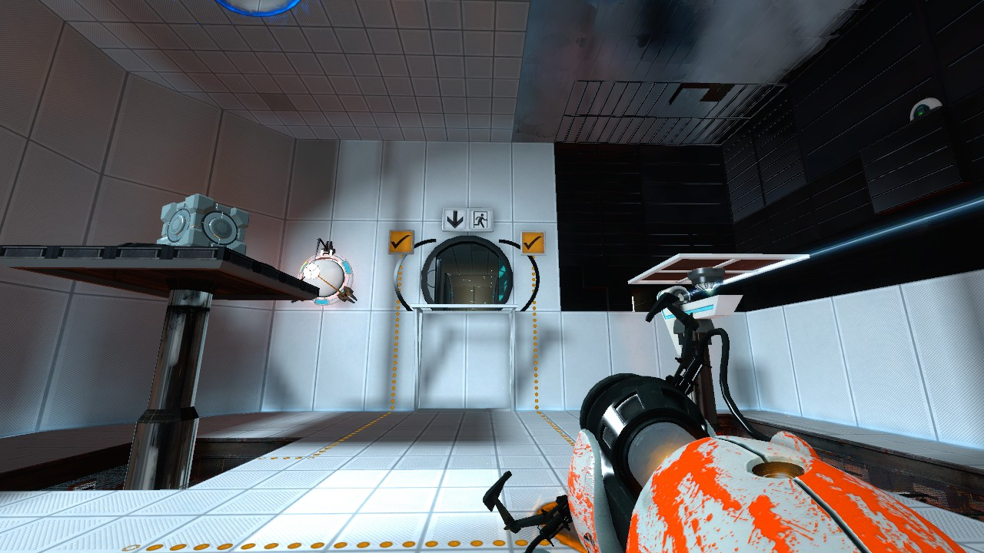
VIDEO GAMES
ARE MORE FUN THAN MATH

Slide 8
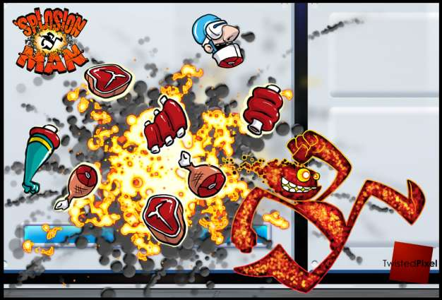
WHAT MAKES VIDEO GAMES
SO AWESOME?

Slide 9
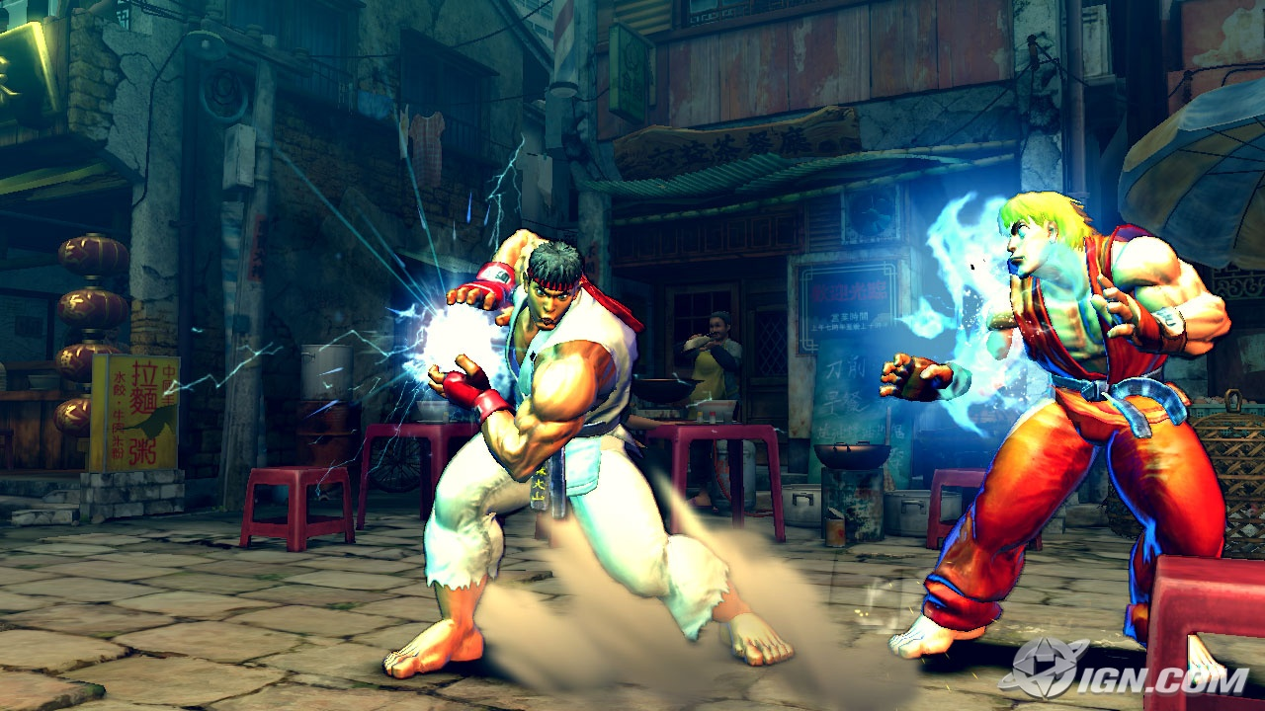
WHAT MAKES VIDEO GAMES
WORK?

Slide 10
OH CRAP.
IT'S PROGRAMMING

Slide 11

PROGRAMMING
MAKES AWESOME GO

Slide 12
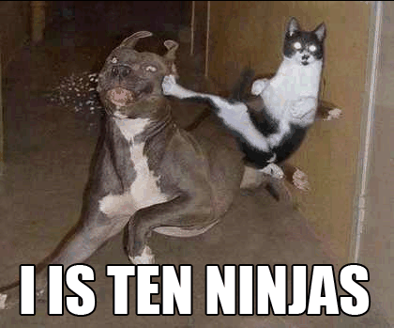
INTRODUCTIONS ARE
HARD. HERE'S A CAT.

Slide 13
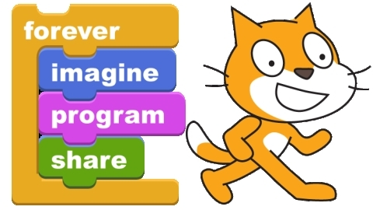
WOULD YOU LIKE
TO PLAY A GAME?

Slide 14

GITHUB.COM/RobSpectre/Talks
@BOXEE_API
#BOXEE
DEVELOPER.BOXEE.TV
/blog

Slide 15
THANK
YOU!

Slide 16
QUES TIONS?

